Slide 1

Your first 100 days
Planning & Managing

Slide 2
Treat the doctorate like a job
Work 9am – 5pm with a lunchbreak
If you work outside of these hours (and it is likely at times) – make sure you have a day off
Get into a routine early in the process

Slide 3
What does the doctorate entail?
Very crudely
A LOT of (critical) reading
Followed by writing up your reading
Thinking about and discussing possible experiments/data/information –i.e. questions to answer
Writing up your thoughts on the above and later, writing will be based on the above
Talking to people in your discipline – networking
Listening to people in your discipline – conferencing, attending seminars (networking)
Alert to suggestions and ideas
Disseminating/promoting your work

Slide 4
Common issues & problems doing a Doctorate
Too much time
How to get into a routine
Perfectionism
Unclear objectives
Supervision
Motivation
Unexpected set backs
Work : Life balance

Slide 5
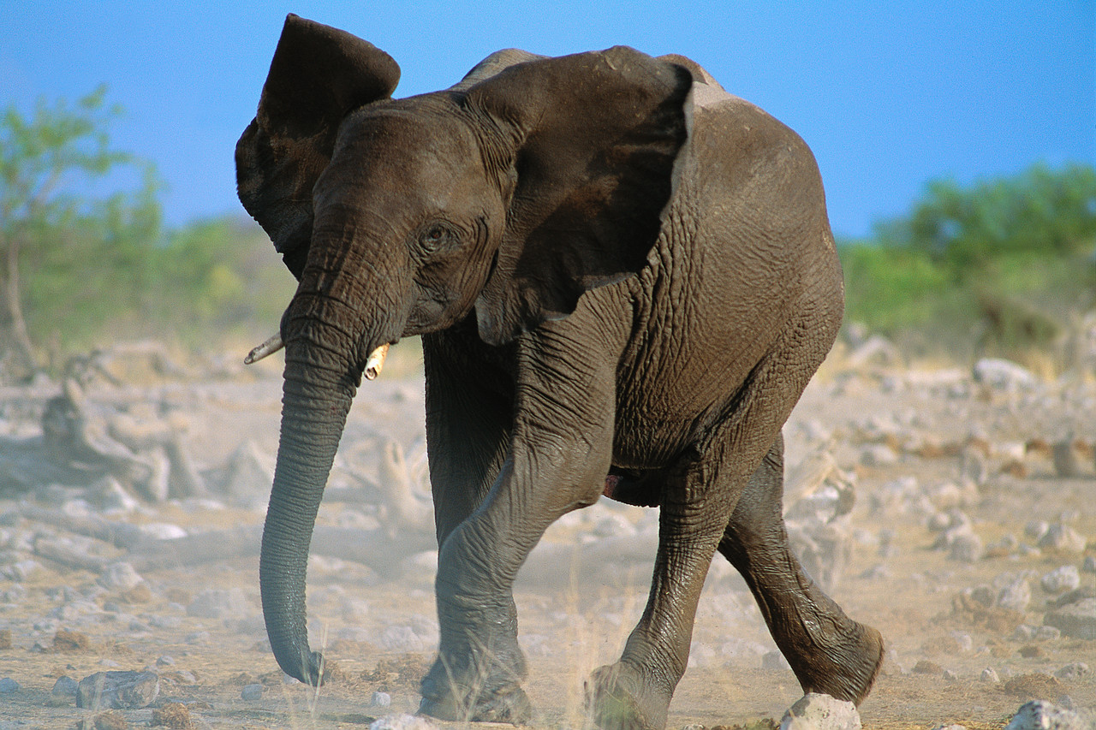
How do you eat an elephant?

Slide 6
Answer: piece by piece (or one bite at a time!)
Stages in project management
Define task
What needs to be done?
Evaluate
How did it go?
What could improve it?
Plan
How can it be done?
Set timed goals
Implement
Actually do it!
Notes:
This model can be used for planning your whole thesis or for part, such as the literature review.

Slide 7
Time on your side…?
Average day = 7 hours
Average week = 35 hours
Average month = 140
Average time spent with supervisor?
1 – 2 hours a month
A lot of time you need to manage

Slide 8
Define the task
  Set the limits
    How much time, resource, equipment?
    Scoping the project
  Agree the activity
    What is included – excluded
    Assess the risks – what could go wrong?
  Plan the details
    Set MILESTONES – CELEBRATE
    Sequencing – in parallel or consecutive
  Monitor progress
Notes:
There are tools and more complex models out there – could use MS project – Prince2 for really big projects – but a spreadsheet is good enough for most of us.

Slide 9
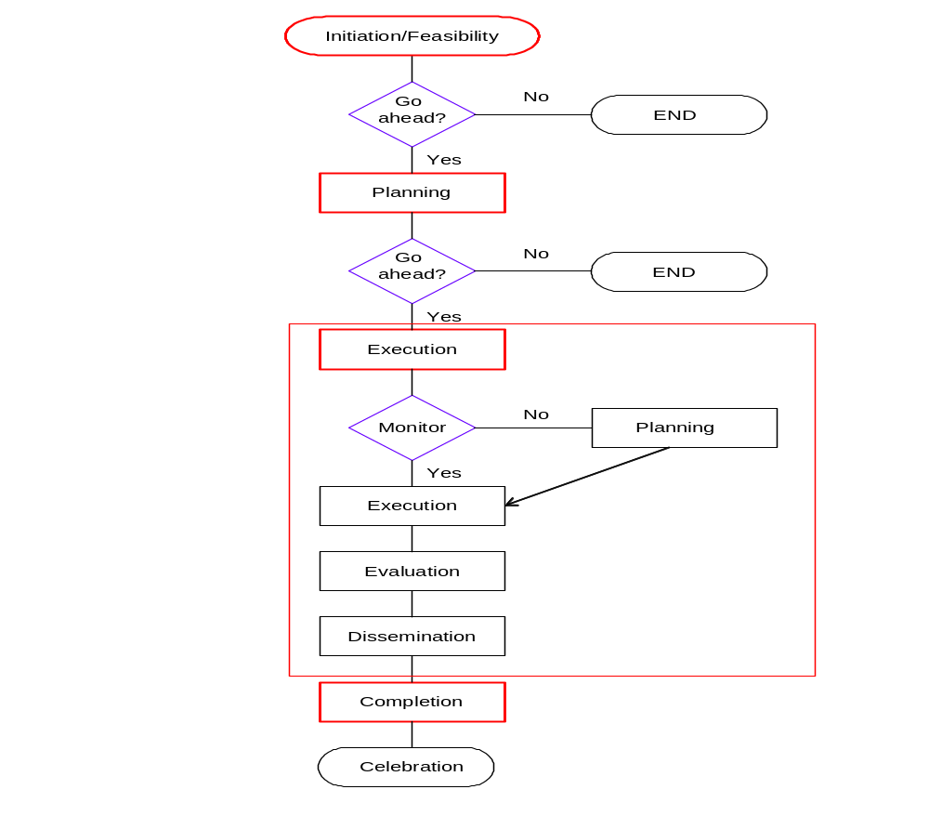

Slide 10
Activity
Think about what you need to do over the next 3-4 years and set up an excel spreadsheet and create a gantt chart
Using the list of activities and items in the checklist you have already looked at - put them into the excel spreadsheet
Identify your key milestones
Plot on your Gantt chart
Use this to keep track of your work progress
Notes:
When will you monitor your progress and how?

Slide 11
Benefits of an effective PhD plan
Be more efficient
Increase motivation
Decrease dependence on others (e.g. supervisor)
Sense of achievement

Slide 12
Project management summary
Effective Project Management is about:
Good time management
Planning and prioritisation
Reviewing
Multi-tasking
Flexibility
Looking for help and support
Developing systems and routines that work for you

Slide 13
Things you have to do…?
Improve
Develop
Acquire
Position
?
Your next 100 days!

